Slide 1

2D Block Brick Survival
SoungBin, Rena, Pin

Slide 2
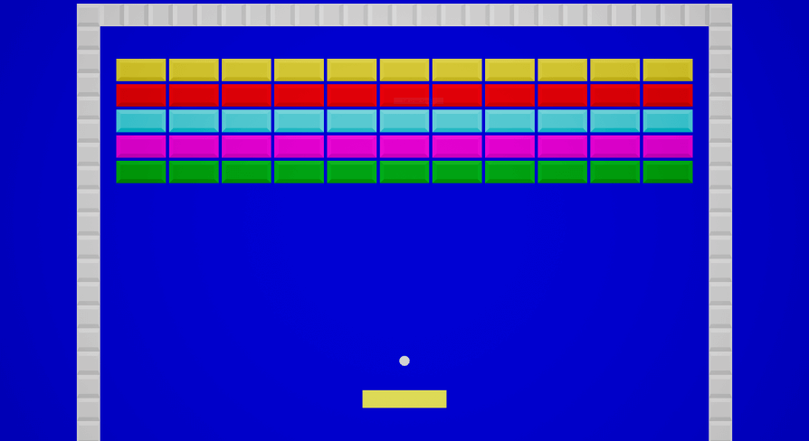
Block Brick Games
When the stick gets damage by the ball, and when those balls are bullet.
Tried to make in the 3D FPS.
There are too many bugs even in 2D.

Slide 3
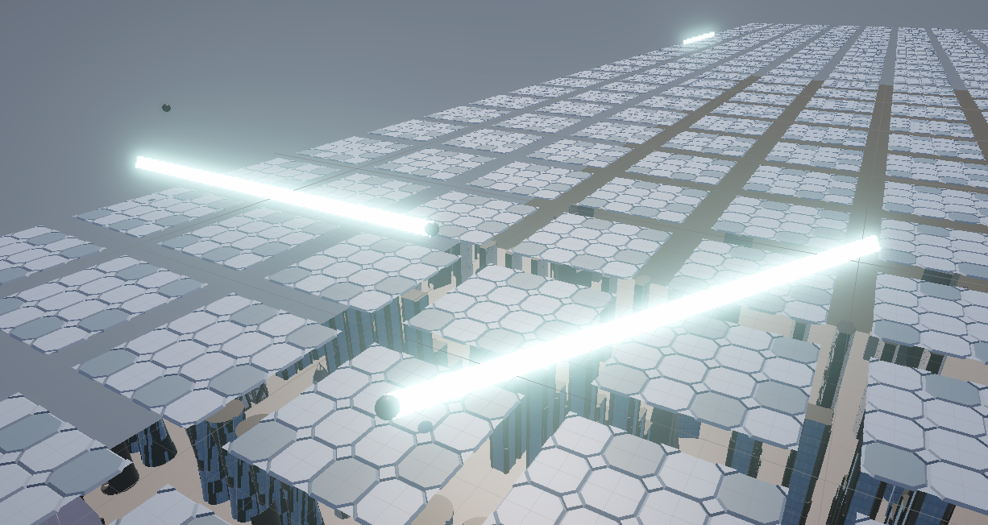
Introduction
Break the blocks find the portal and go to next level.
You shoot blasters and the blasters will reflect everywhere forever
Dodge the blasters
Inspired from Lightsaber
Reach the highest level

Slide 4
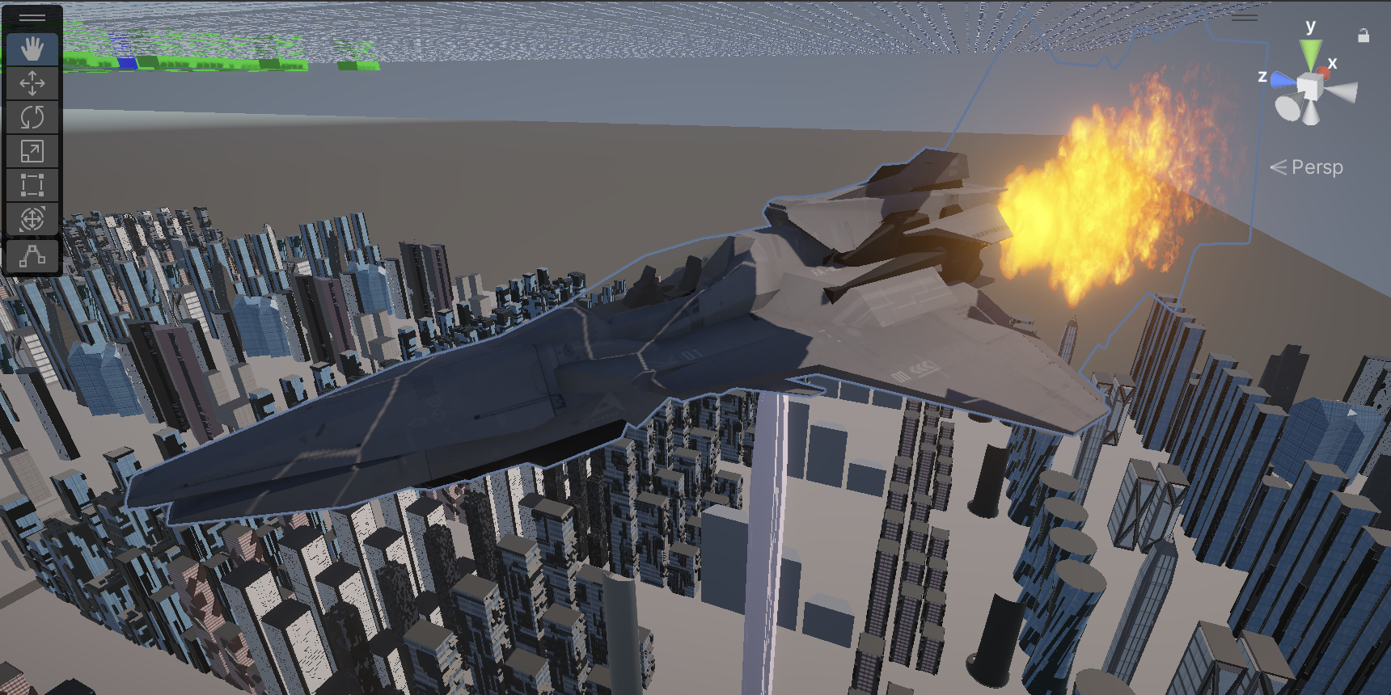
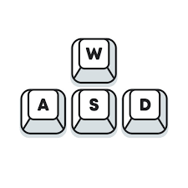


Control
You need a wasd, shift for dash(teleport), mouse for aiming and left click for shooting blasters

Slide 5
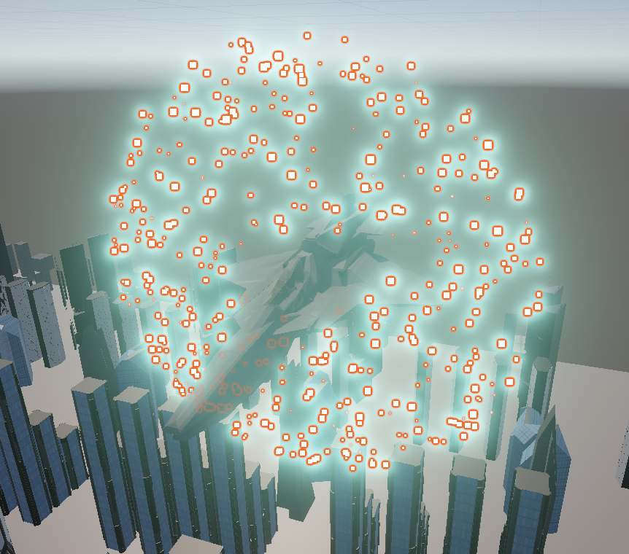
Dash Effect
Teleport the place you want
Find Jet much easier after dash
Looks cool
Inspired from Double 00 Raiser

Slide 6
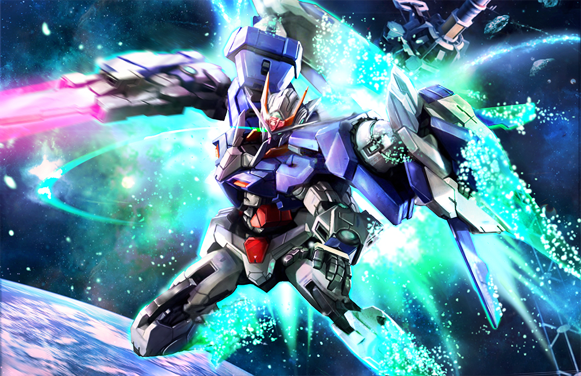

Slide 7
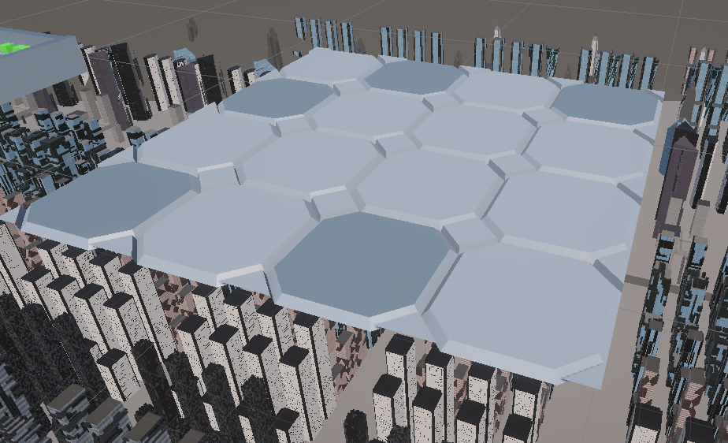
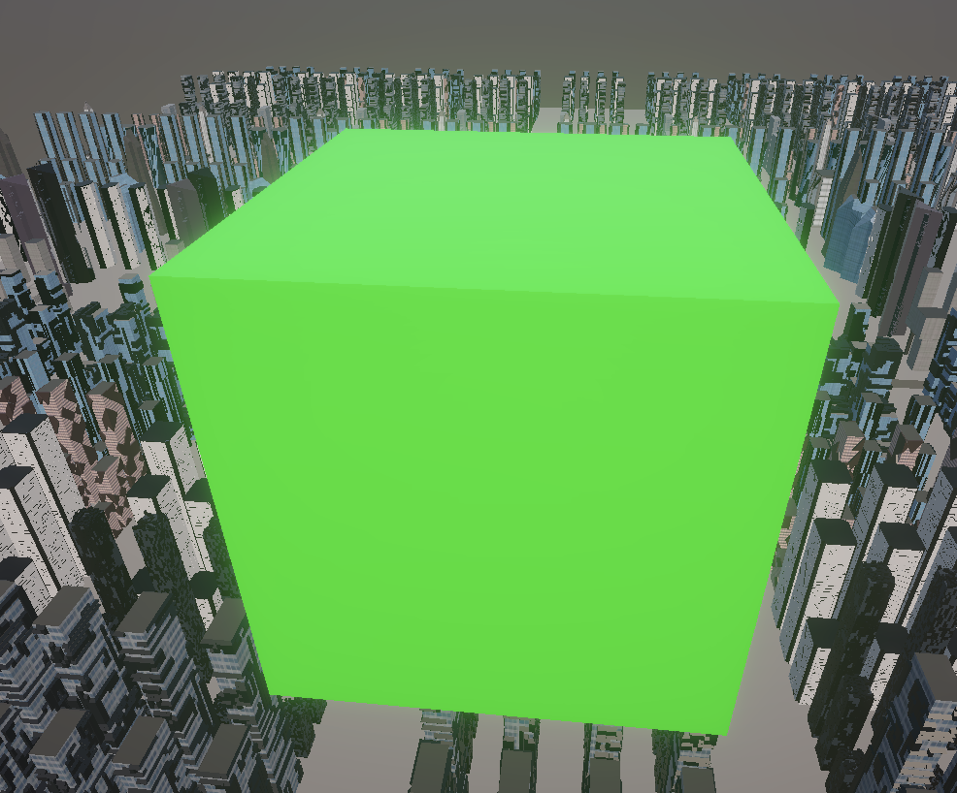
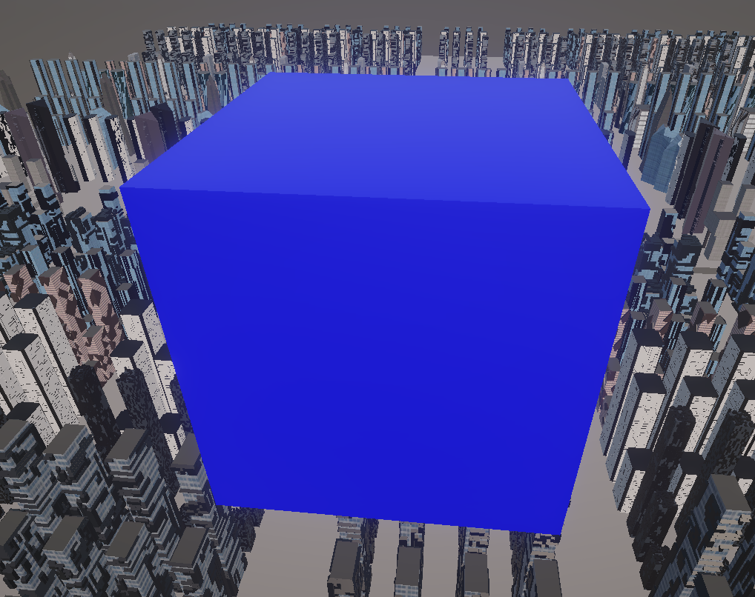
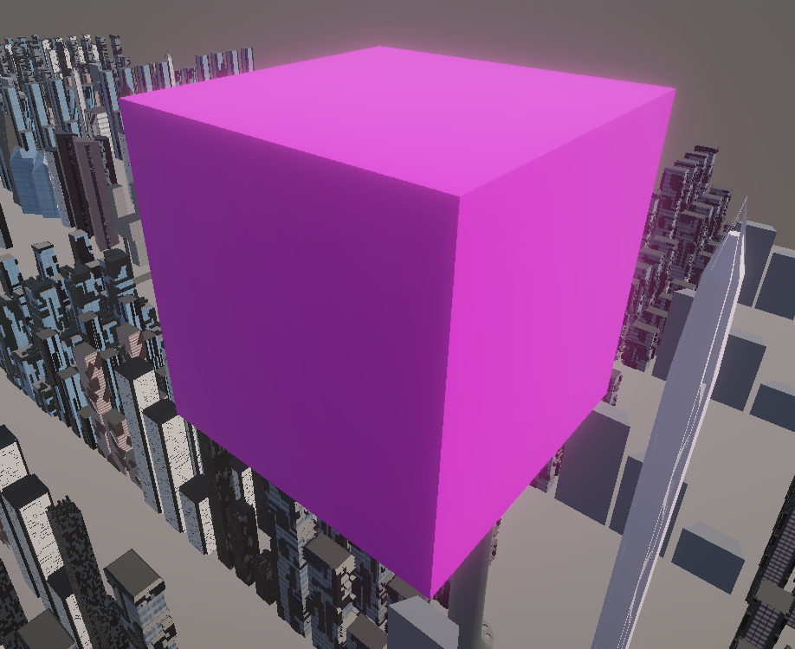
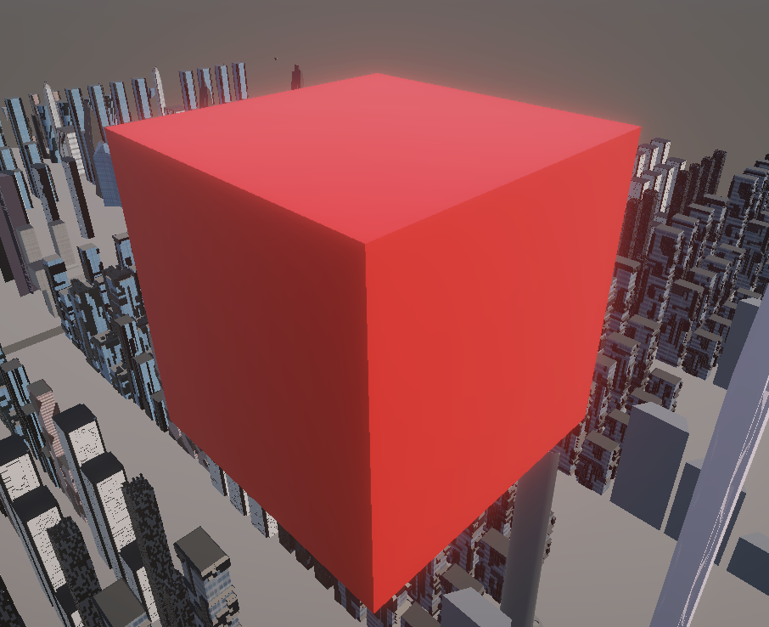
Blocks
Each of hits needed per color and will spawn on this tile
Green1, Blue 3, Purple 5, Red 10

Slide 8
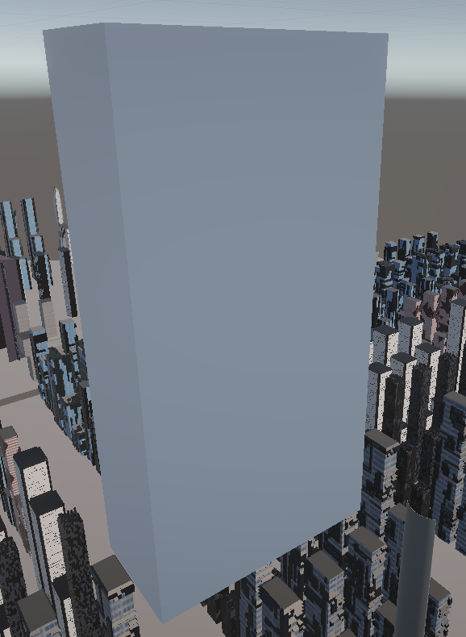
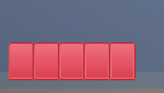
Unbreakable wall and HP
The walls will only reflects the bullet
5HP for max
1 HP per bullet
When the jet hits or dash the wall or block it will take 5 HP

Slide 9
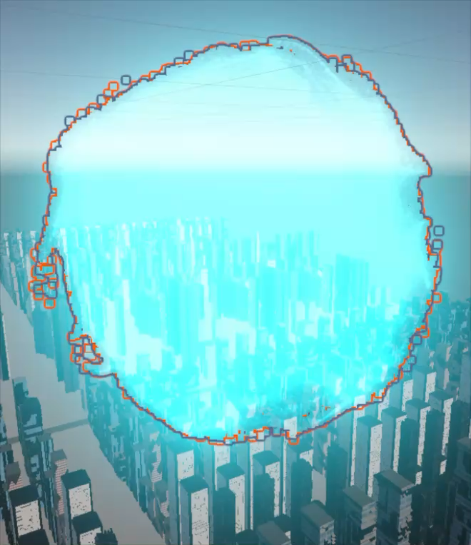
Portal
In Each level appears only for once from the block
Spawn with sound to make sure you know it showed up

Slide 10
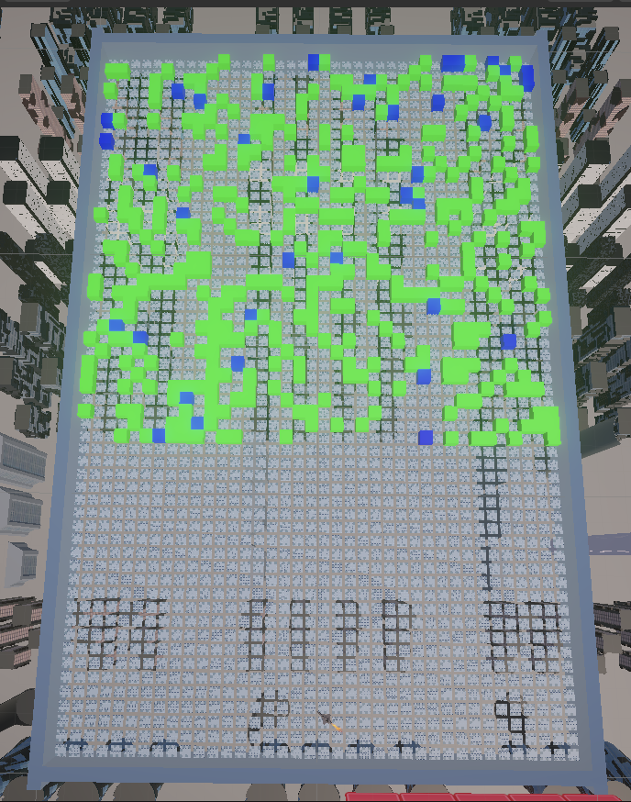
Map
Increses z + 1 line tile every next level
60% of the blocks have 50% spawn blocks

Slide 11
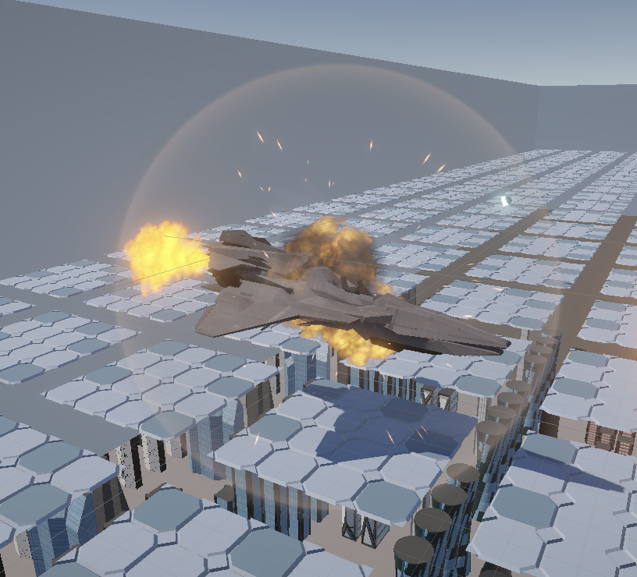
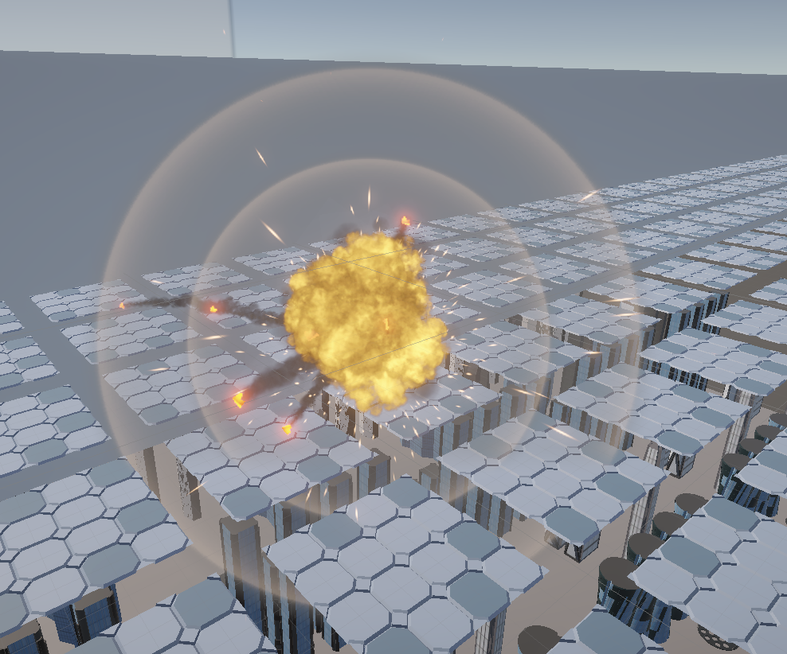
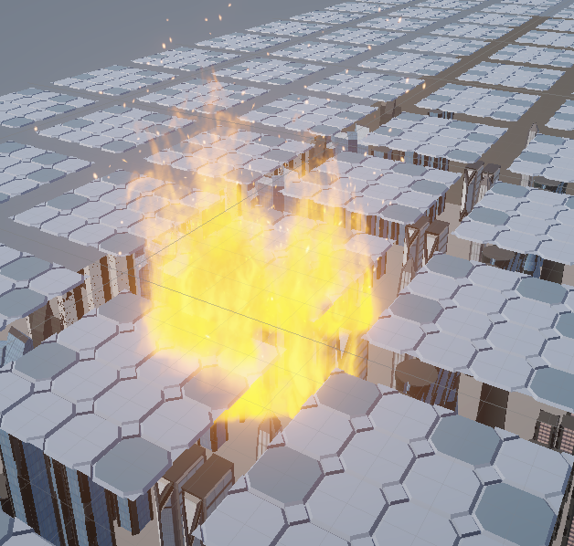
When jet gets hit
1 HP
5HP
------------>

Slide 12
Thank you

